Slide 1
GET Buddied Up
German with Ali, the Eagle
get-across-borders@uni-mainz.de
© 2020 - GET Across Borders

Slide 2
Deutsch lernen mit Ali, unserem Adler Sigrid Rieuwerts get-across-borders@uni-mainz.de

Slide 3
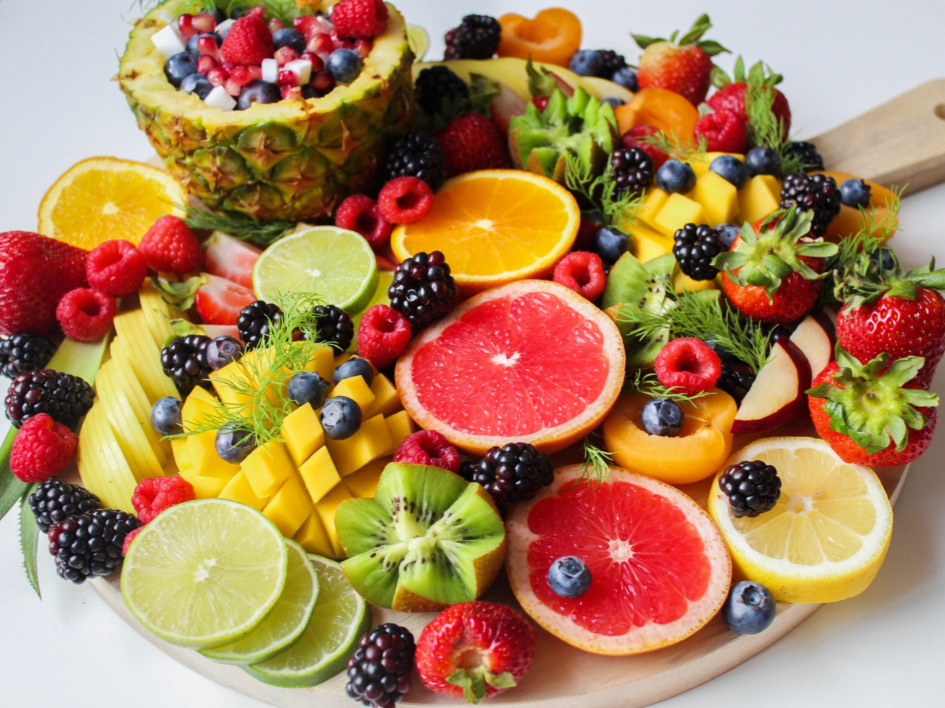
Welcome!
What we are going to learn today:
seven fruits in German (singular and plural forms)
= sieben Früchte
©Pexels
© GET Across Borders

Slide 4
ein Apfel (viele) Äpfel
©Pexels
©Pexels
© GET Across Borders

Slide 5
eine Banane (drei) Bananen
©Pexels
©Pexels
© GET Across Borders

Slide 6
eine Erdbeere (zwei) Erdbeeren
©Pexels
©Pexels
© GET Across Borders

Slide 7
eine Kirsche (viele) Kirschen
©Pexels
©Pexels
© GET Across Borders

Slide 8
eine Orange (viele) Orangen
©Pexels
©Pexels
© GET Across Borders

Slide 9
eine Birne (viele) Birnen
©Pexels
©Pexels
© GET Across Borders

Slide 10
eine Traube (viele) Trauben
©Pexels
©Pexels
© GET Across Borders

Slide 11
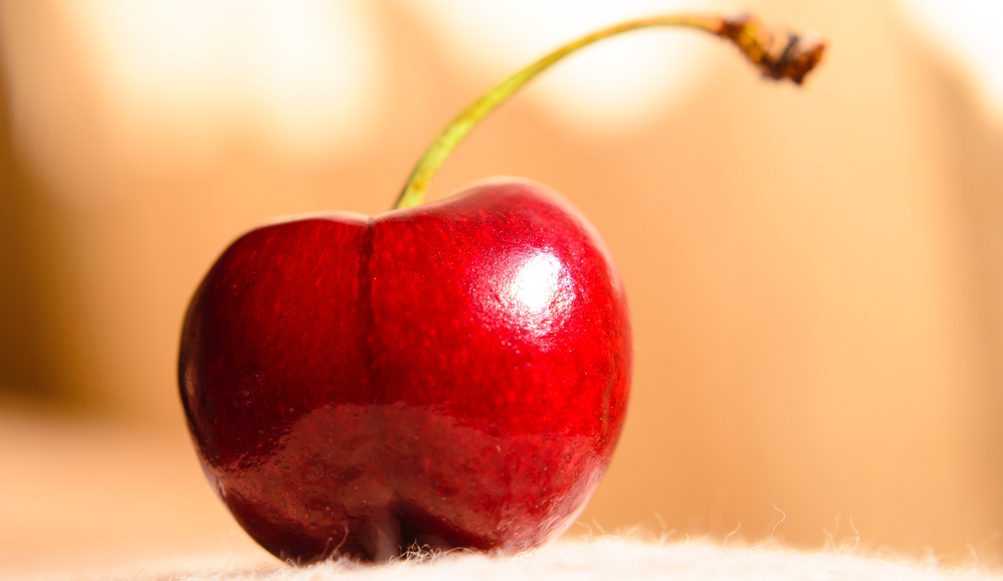
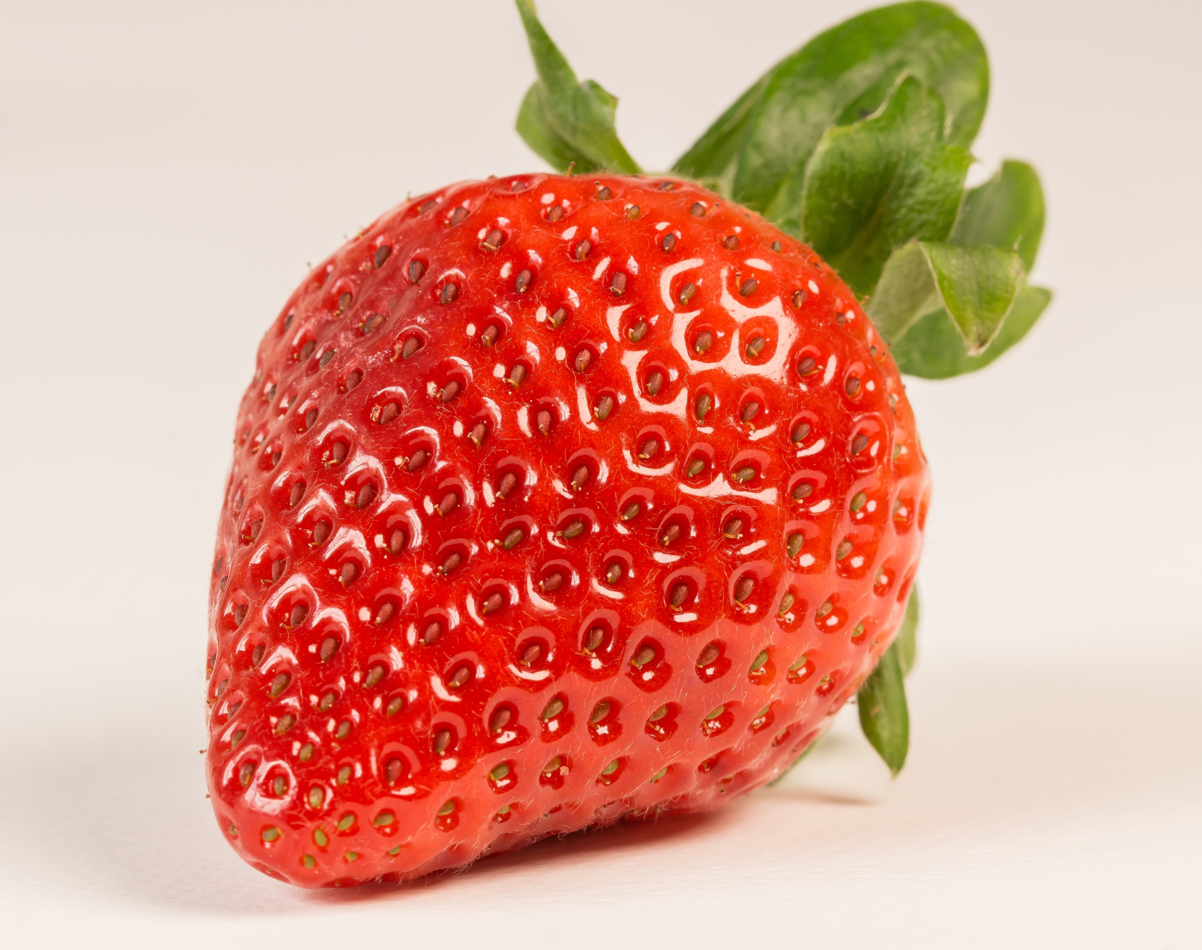
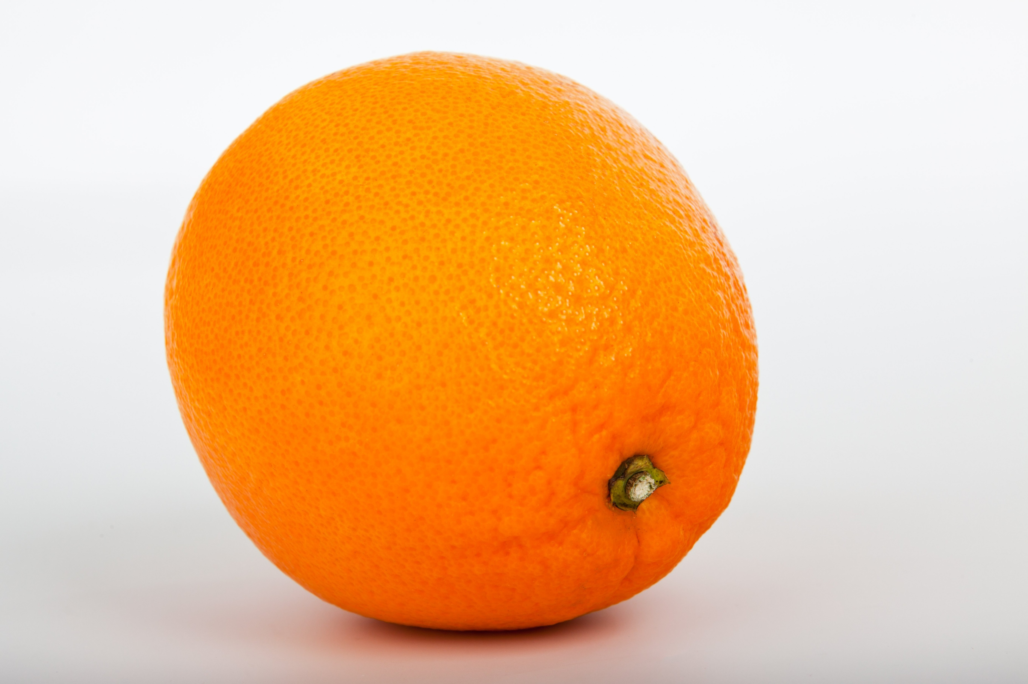
Match the photos with the correct German vocabulary!
eine Orange
eine Banane
ein Apfel
eine Erdbeere
eine Traube
eine Birne
eine Kirsche
©Pexels
© GET Across Borders

Slide 12
Add the missing singular / plural form!
eine Erdbeere ___________
_________ Äpfel
eine Orange ___________
_________ Bananen
eine Trauben ___________
eine Kirsche ___________
© GET Across Borders

Slide 13
Solution
eine Erdbeere Erdbeeren
ein Apfel Äpfel
eine Orange Orangen
eine Banane Bananen
eine Traube Trauben
eine Kirsche Kirschen
© GET Across Borders

Slide 14
Summary
Name at least 5 different fruits in German.
Apfel (Äpfel)
Banane (n)
Erdbeere (n)
Kirsche (n)
Orange (n)
Birne (n)
Traube (n)
© GET Across Borders

Slide 15
Sources
© GET Across Borders

Slide 16
© GET Across Borders

Slide 17
Thank you for learning German with us! ☺
DISCLAIMER: Please note that any resources uploaded to this website are purely for educational purposes only. If any of the items, photos or texts uploaded are in infringement of copyright then please do not hesitate to contact us and we will have them removed.
© 2020 – GET Across Borders and © Leap4Joy

