Slide 1






GET Buddied Up
German with Ali, the Eagle
get-across-borders@uni-mainz.de
© 2020 - GET Across Borders

Slide 2
Deutsch lernen mit Ali, unserem Adler
Sigrid Rieuwerts get-across-borders@uni-mainz.de

Slide 3
Herzlich willkommen!
Today we will talk about…
classroom objects (Objekte im Klassenzimmer)
and what you can do with them.
© GET Across Borders
3

Slide 4
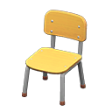

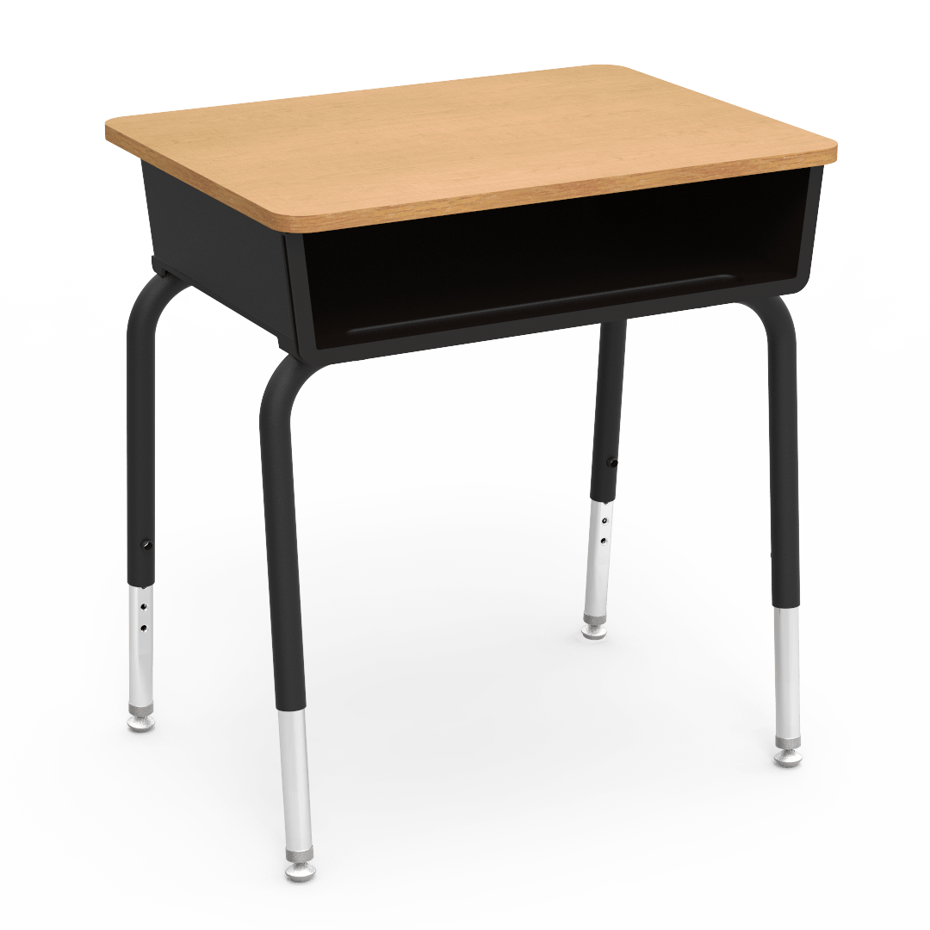
Objekte im Klassenzimmer
der Stuhl
der Tisch
Dodo
PNG ALL
© GET Across Borders
4

Slide 5


Objekte im Klassenzimmer
der Computer
die Tür
© Pixabay
Gamepedia
© GET Across Borders
5

Slide 6

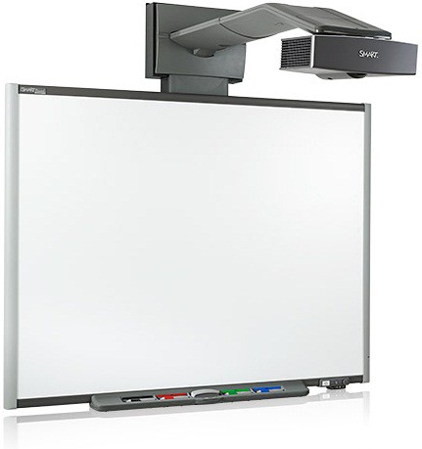
Objekte im Klassenzimmer
das Fenster
die Tafel
Hausjournal
Staticflickr
© GET Across Borders
6

Slide 7
Objekte im Klassenzimmer
Was passt zusammen?
Match the pictures with the correct words!
© GET Across Borders
7

Slide 8
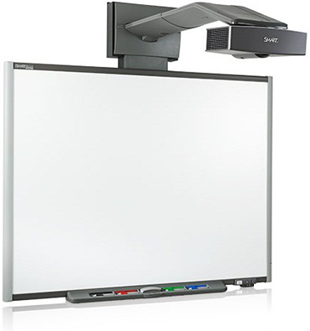

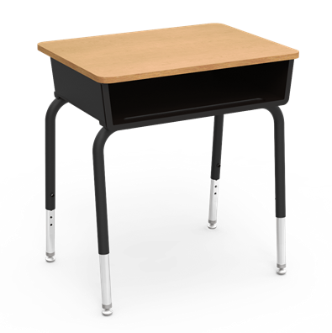
Objekte im Klassenzimmer
Stuhl Tisch Tafel
Staticflickr
Dodo
PNG ALL
© GET Across Borders
8

Slide 9



Objekte im Klassenzimmer
Tür Fenster Computer
© Pixabay
Hausjournal
Gamepedia
© GET Across Borders
9

Slide 10
Objekte im Klassenzimmer
Was machen wir im Klassenzimmer?
We will now take a look at what you can do with the classroom objects.
© GET Across Borders
10

Slide 11
Objekte im Klassenzimmer
den Stuhl einschieben – push in the chair
den Tisch aufräumen – tidy up the desk
den Computer einschalten – switch on the computer
den Computer ausschalten - switch off the computer
© GET Across Borders
11

Slide 12
Objekte im Klassenzimmer
die Tür öffnen – open the door
die Tür schließen – shut the door
das Fenster öffnen – open the window
das Fenster schließen – shut the window
die Tafel einschalten – switch on the whiteboard
die Tafel ausschalten – switch off the whiteboard
© GET Across Borders
12

Slide 13
Objekte im Klassenzimmer
Ein Spiel!
A game:
One volunteer performs an action of their choice (e.g. closing the window), the others have to name the action in German.
© GET Across Borders
13

Slide 14
Anweisungen
command - Anweisung
All of the actions can be phrased as commands.
If your teachers or your classmates ask you to do something, it would look like this.
© GET Across Borders
14

Slide 15
Anweisungen
Bitte schiebe den Stuhl ein.
Please push in the chair.
Bitte räume den Tisch auf.
Please tidy up the desk.
Bitte schalte den Computer ein/aus.
Please switch on/off the computer.
© GET Across Borders
15

Slide 16
Anweisungen
Bitte öffne die Tür. - Please open the door.
Bitte schließe die Tür. - Please shut the door.
Bitte öffne das Fenster. - Please open the window.
Bitte schließe das Fenster. – Please shut the window.
Bitte schalte die Tafel ein/aus. – Please switch on/off the whiteboard.
© GET Across Borders
16

Slide 17
Anweisungen Partner A
You will give your partner the following classroom commands in German which he or she has to perform:
Please open (or close) the window.
Please turn on (or off) the board.
Please slide in the chair.
After that you will perform your partner’s commands.
© GET Across Borders
17

Slide 18
Anweisungen Partner B
You will perform your partner’s commands.
After that, you will give your partner the following classroom commands in German which he or she has to perform:
Please tidy up the table.
Please turn on (or off) the computer.
Please open (or close) the door.
© GET Across Borders
18

Slide 19
Sources
https://dodo.ac/np/images/a/ac/School_Chair_%28Natural_%26_Silver%29_NH_Icon.png
http://www.pngall.com/wp-content/uploads/2/Desk-PNG-HD-Image.png
https://cdn.pixabay.com/photo/2013/07/13/11/47/computer-158675_960_720.png
https://gamepedia.cursecdn.com/minecraft_de_gamepedia/thumb/0/06/Schwarzeichenholzt%C3%BCr.png/150px-Schwarzeichenholzt%C3%BCr.png?version=7791992046ca13d79f92a6756a95e211
https://www.hausjournal.net/wp-content/uploads/Kosten-Fenster-Einfamilienhaus.jpg
https://c1.staticflickr.com/6/5255/5570898684_a595f1c923.jpg
© GET Across Borders
19

Slide 20
Thank you for learning German with us! ☺
DISCLAIMER: Please note that any resources uploaded to this website are purely for educational purposes only. If any of the items, photos or texts uploaded are in infringement of copyright then please do not hesitate to contact us and we will have them removed.
© 2020 – GET Across Borders and © Leap4Joy

